Slide 1
WEB Programming
Chapter 5:
JavaScript and HTML Documents
By : Tamal Dey
Assistant Professor,
Dept. of MCA, PESU

Slide 2
Index
JavaScript Execution Environment
The Document Object Model
Element access in JavaScript
Events and Event Handling
Handling Events from Body Elements
Handling Events from Button Elements
Handling Events from Textbox and Password elements
The DOM 2 Event Model
The navigator Object
DOM Tree Traversal and Modification

Slide 3
JavaScript Execution Environment
A browser display HTML document in a window on a screen of the client. The JavaScript Window object represents the window that displays the document
  http://www.w3schools.com/jsref/obj_window.asp
The properties of window object are visible to all JavaScript script that appears in the window’s HTML document
Global variables are created implicitly in client-side for implementing a new property of window object
  http://www.w3schools.com/js/js_window.asp
Here we are discussing about single window object that include multiple frames

Slide 4
JavaScript Environment
Document object have property arrays for anchors, links, images and applets
The Document object represents the document displayed
The Windows object has a property named as document which is references to the Document object
Every document object has a forms array, each element of which represents a form in the document.
Each Forms array element has an elements array as a property ,which contains the objects that represent the HTML form elements, such as buttons and menus

Slide 5
Document Object Model
DOM 0 has been developed by W3C in 1990s.
DOM 1 (Oct- 1998) focused on XHTML and XML
DOM 2 (Nov-2000) was the latest version specifies style sheet object model and defines how style information attached to a document can be manipulated.
It also provides document traversal and complete event model
FX2 supports DOM 2 but IE7 doesn’t support
  See this http://quirksmode.org/dom/core/
DOM3 was under development which deals with content model for XML , document validation, document views and formatting as well as key events and event groups

Slide 6
DOM is useful to provide a specification that would make Java and JavaScript to deal with HTML document, portable among various browsers
Previously DOM 0 was compatible for Netscape 3 and IE 3
DOM 0 was partially documented in HTML 4 specification
DOM is an API (Application Programming Interface) defines an interface between HTML documents and application program
  http://www.w3.org/DOM/
DOM is used to create document and move around the structure and change, add, delete element and their content

Slide 7
DOM Example
Documents in DOM have a tree like structure but there can be more than one tree in a document because DOM is an abstract interface. Here data are called properties and operations are called methods
  <input type = “botton” name= “Proceed” onclick=“ex()”>
<html><head> <title> A simple document </title> </head>
<body> <table>
<tr> <th> Breakfast
</th>
<td> 0</td> <td> 1 </td>
<tr>
<tr> <th> Lunch </th>
<td> 0</td>
<td> 1 </td>
<tr>
</table>
</body> </html>

Slide 8
DOM Structure for this table
Document
<body>
<head>
<table>
<title>
<tr>
<tr>
“A simple documents”
<th>
<td>
<td>
<th>
<td>
<td>
“Breakfast
“0”
“1”
“Lunch”
“1”
“0”

Slide 9
Element Access in JavaScript
Elements of HTML document have corresponding objects that are visible to an embedded JavaScript script
Object associated with an HTML form element can be addressed in JavaScript
The address of JavaScript object are associated with an HTML element as its DOM address
Multiple ways of element access
  DOM Address
  Element Names
  By method getElementById (defined in DOM 1)

Slide 10
DOM address using Array element
The DOM address of the button using form and elements array is like this:
  Var dom = document.forms[ 0 ].elements[ 0 ];
DOM address defined by address element can change
  E.g, New button added
Consider this simple form:
<form name= "myForm" action = " ">
<input type = "button" name = "turnItOn” / >
</form>

Slide 11
DOM addressing with Element names
Consider this simple form:
<form name= "myForm" action = " ">
<input type = "button" name = "turnItOn” / >
</form>
• The input element can be refere by name attrribute:
var dom = document.myForm.turnItOn;

Slide 12
Using Id attribute
Using getElementById with id attributes defined in DOM 1
  id attribute value must be unique for an element
    var dom = document . getElementById(“turnItOn”)

Slide 13
Object Hierarchy
Fully-qualified location of an Object
Allows multiple instances of similar objects
Avoids duplication of object names
Window
    Document
      Form
        Object
        Property or method
        Value or action
  document.form1.button3.value= "ClickMe"

Slide 14
Programming JavaScript
Variables
  Named elements that can change value
    Howdy, numberRight, score, Ralph
Data types
  Integer, floating-point, boolean, string
    12, 987.654, true/false, “Texas Tech”
Operators
  Assignment, comparison, boolean, string
    >=, ==, +=, ||, <, >, etc.

Slide 15
Programming JavaScript
Control statements
  Conditions, loops
    If, if….else, for, etc.
Keywords
  Reserved words with special meaning
    var, true, false, int, const, new, return
Notes:
For checking, it’s not if x = 5, but if x == 5

Slide 16
Event Handlers
Event
  A notification of something occurred
    Action by browser user
      Browser event e.g. Loading of document
  Examples
    Mouse click
    Loading of page, Image loading
    Selecting a form field, submit a form
    Key stroke

Slide 17
Event Handling
Caution! Don’t use document.write(...) in event handler
Called automatically when events occur
  onClick, onMouseDown, onMouseUp
  onFocus, onBlur, onKeyPress
  onLoad, onUnload, onSubmit

Slide 18
Example Code
<h2>Example 2: Mouseover Picture Change</h2>
<p>When you move your mouse over this picture, JavaScript will swap in a second picture immediately upon the Mouseover event.&nbsp; Immediately upon Mouseout,the first picture will be immediately swapped.</p>
<img border=“4" src="../images/Locke3.gif" width=“300" height=“250"
OnMouseOver="this.src='../images/Locke1.gif'"
ONMouseOut="this.src='../images/Locke3.gif '“
Output to server

Slide 19
Events and Event Handeling
HTML 4.0 provides first specification of an event model which is referred as DOM 0 event model
Event handling can be divided into two parts
  DOM 0 Model
  DOM 2 Model
We take DOM 2 as standards

Slide 20
Basic Concept of Event Handling
Use of JavaScript for web programming is to detect certain activities of the browser and browser user and provide computation when the activities occur
This computation are specified a special form of programming called event-driven programming
Event-driven programming: A parts of a program are executed at completely unpredictable times, often triggered by user interaction with the executing program
In conventional (non-event-driven) has some specific order of execution and usually affected by program’s input data

Slide 21
Event Handling
An event is a notification that something specific has occurred either with browser (completion of loading a document) or a browser user action (mouse click on form button)
An event is an object that is implicitly created by the browser and the JavaScript system in response to something is happening
An event handler is a script that is implicitly executed in response to the appearances of event
Common use of event handler is to check for errors in user input when they are changed or the form is submitted

Slide 22
Event Handling
Events are JavaScript object and their names are case sensitive. The name of event object have only lower case letters.
  E.g. – click is an event but Click is not
The process of connecting an event handler to an event is called registration
There are two approaches to event handler registration
  By assigning the event handler script to an event tag attribute
    onclick = "alert('Mouse click!');"
    onclick = "myHandler();"
  Through assign handler address to object properties

Slide 23
Event, Attributes and Tags
HTML has collection of events that can be implemented with JavaScript in browser
Events are associated with HTML tag attributes
This attributes have names closely related to associated events
A method called get focus when the user puts the mouse cursor over it and clicks the left most button
An element can also get focus when the user tabs to the element
Focus on an element can be forced with focus method

Slide 24
Event Tag Attribute Event Tag Attribute
blur
change
click
dblclick
focus
keydown
keypress
keyup
load
unload
onblur
onchange
onclick
ondblclick
onfocus
onkeydown
onkeypress
onkeyup
onload
onunload
mousedown
mouseout
mouseover
mouseup
reset
select
submit
onmousedown
onmouseout
onmouseover
onmouseup
onreset
onselect
onsubmit

Slide 25
Events...
onload, onunload
  When user enters/leaves the web page
  Often used to deal with cookies
  onload used for checking browser version/type
<html><head><script>
function load()
{alert("Page is loaded");}
</script></head>
<body onload="load()">
<h1>Hello World!</h1>
</body></html>
<body onunload="goodbye()">

Slide 26
onsubmit
  Typically used for validating all fields together
onmouseover
  To dynamically display quick info when mouse is on some content
onfocus, onblur, onchange
  Typically used for validation of form field(s)

Slide 27
Attributes and related events
Onblur <a> - loses focus
  <button> - loses focus
  <input> - loses focus
  <input type="text" name="fname" id="fname" onblur="upperCase()">
  <textarea> - loses focus
  <select> - loses focus
onchange
  <input> - element is changed and loses focus
  <input type="text" name="txt" value="Hello" onchange="checkField(this.value)">
  <select> - element is changed and loses focus
  <textarea> - element is changed and loses focus

Slide 28
Attributes and related events
onclick
  <a> - user clicks on the link
  <input> - user clicks on input element
onfocus - acquires input focus
  <a>
  <input>
  <textarea>
  <select>

Slide 29
Attributes and related events
onkeydown
  <body>, <form> elements
Onkeypress (keyboard)
  <body>, <form> elements
onkeyup
  <body>, <form> elements
Onload <body> - document finished loading

Slide 30
Attributes and related events
onmousedown, onmousemove, onmouseover
  Most elements
onreset
  <form> - reset button is clicked
onselect
  <input> - cursor is moved over to the element
  <textarea> - text area is selected within textarea element
onsubmit
  <form> - submit button is pressed
onunload
  <body> - user exits the document

Slide 31
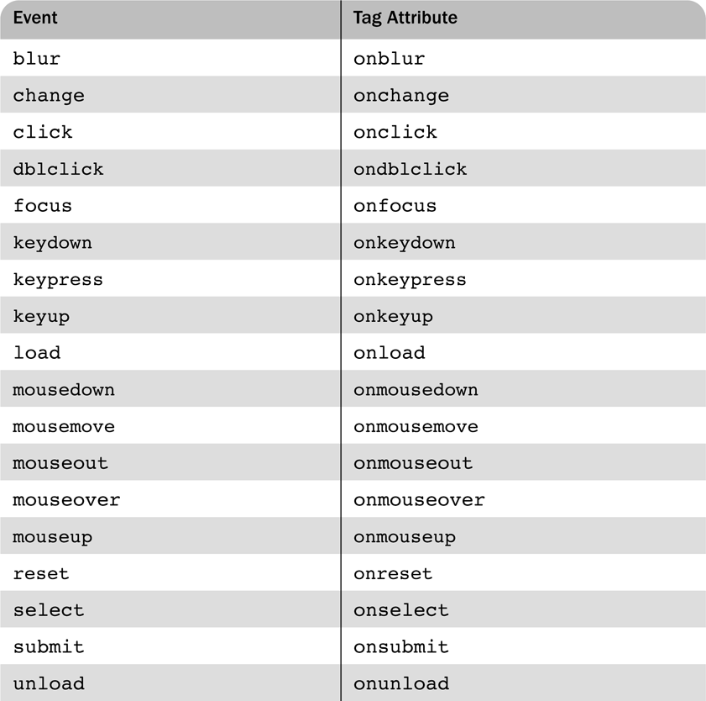
Events and their tag attributes

Slide 32
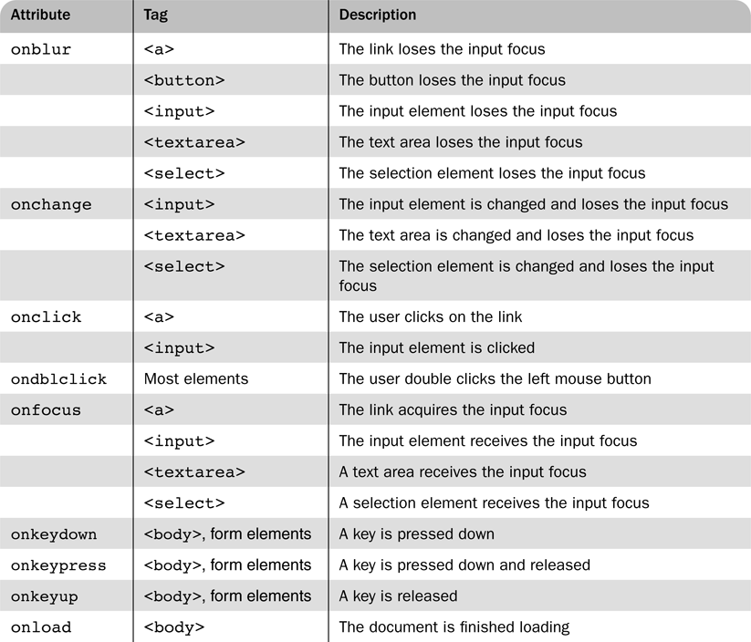
Event attributes and their tags

Slide 33
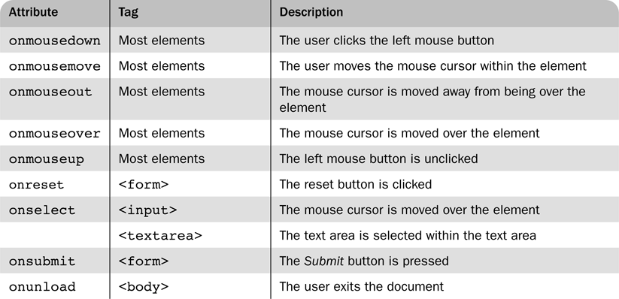
Event attributes and their tags (cont)

Slide 34
Handling multiple statement
DOM 0 event handler script to an event tag attribute
  <input type = “button” id = “myButton”
  onclick = “alert ( ‘You clicked my button !);
  onclick = “myButtonHandeler();” />
Event handler could register by the assignment to the associate event property on the button object
  document.getElementById(“myButton”).onclick = myButtonHandler;

Slide 35
Handling Events from Body Elements
load event - triggered when the loading of a document is completed.
  Load: produce alert message.
  unload: produce alert message.
  Examples
    load.html, load.js

Slide 36
Handling Events from Button Elements
Plain Buttons – use the onclick property
  Radio buttons
    If the handler is registered in the markup, the particular button that was clicked can be sent to the handler as a parameter
  e.g., if planeChoice is the name of the handler and the value of a button is 172, use
    onclick = ″planeChoice(172)″
  This is another way of choosing the clicked button
radio_click.html radio_click.js

Slide 37
Handling Events from Button Elements (continued)
If the handler is registered by assigning it to a property of the JavaScript objects associated with the HTML elements. As in:
  var dom = document.getElementById(″myForm″) dom.elements[0].onclick = planeChoice;
This registration must follow both the handler function and the XHTML form
If this is done for a radio button group, each element of the array must be assigned
In this case, the checked property of a radio button object is used to determine whether a button is clicked

Slide 38
If the name of the buttons is planeButton
var dom = document.getElementById(″myForm″);
for (var index = 0;
index < dom.planeButton.length; index++) {
if (dom.planeButton[index].checked) {
plane = dom.planeButton[index].value;
break;
}
}
radio_click2.html
radio_click2.js
radio_click2r.js

Slide 39
Handling Events from Button Elements (continued)
The disadvantage of specifying handlers by assigning them to event properties is that there is no way to use parameters
The advantages of specifying handlers by assigning them to event properties are:
1. It is good to keep HTML and JavaScript separate
2. The handler could be changed during use

Slide 40
Handling Events from Textbox and Password Elements
The Focus Event
  Can be used to detect changes to a text box by blurring the element every time the element acquires focus
nochange.html nochange.js
Checking Form Input
  A good use of JavaScript, because it finds errors in form input before it is sent to the server for processing
  So, it saves both:
1. Server time, and
2. Internet time

Slide 41
Things that must be done:
1. Detect the error and produce an alert message
2. Put the element in focus (the focus function)
3. Select the element (the select function)
The focus function puts the element in focus, which puts the cursor in the element
document.getElementById("phone").focus();
The select function highlights the text in the element
  document.getElementById("phone").select();

Slide 42
Password
To keep the form active after the event handler is finished, the handler must return false
Problems:
1. With IE6, focus and select only work if the handler is registered by assigning it to the element event property
2. With NS7, select works, but focus does not
Comparing pass_chk.html pass_chk.js pass_chkr.js
The form just has two password input boxes to get the passwords and Reset and Submit buttons
The event handler is triggered by the Submit button

Slide 43
Handler actions:
1. If no password has been typed in the first box, focus on that box and return false
2. If the two passwords are not the same, focus and select the first box and return false if they are the same, return true

Slide 44
The DOM 2 Event Model
DOM 2 was issued in November 2000 and supported by FX2 browser.
It specifies a style sheet object model and defines how style information attached to a document can be modified.
DOM 2 also includes traversals and provides a complete and comprehensive event model.
DOM 2 event model does not include any features of the DOM 0 event model.
It is more sophisticated and powerful then DOM 0.

Slide 45
JavaScript operation
  Smooth Scrolling with Button
  Event handler
  JavaScript as attribute value
  External .js function call
  Loop

Slide 46
The DOM 2 Event Model
Event Propagation
Event Handler Registration
Form_Check.html Form_Check.js

Slide 47
The DOM 2 Event Model
The real drawback of using the DOM 2 model is that Microsoft has yet to provide support for it in its browsers.
The DOM 2 model is a modularized interface.
One of the DOM 2 modules is Events, which includes several sub modules. The most commonly used are HTML Events and Mouse Events.
When an event occurs and there is an event handler that is called, an object that implements the event interface associated with the event type is implicitly passed to the handler.

Slide 48
The DOM 2 Event Model
The interfaces and events defined by these modules are as follows :-
Module | Event Interface | Event Type
HTMLEvents | Event | abort, blur, change, error, focus, load, reset, resize, scroll, select, submit, unload
MouseEvents | MouseEvent | click, mousedown, mousemove, mouseout, mouseover, mouseup

Slide 49
Event Propagation
The event-handler is created at a node in the document tree. For that event, that node is called the target node. Event creation causes a three-phase process to begin.
Capturing phase
Execution phase
Bubbling phase
Dom2

Slide 50
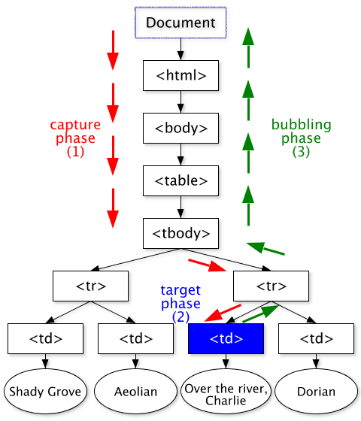
Event Propagation

Slide 51
Capturing phase
The event starts at the document root node.
propagates down the tree to the target node.
If there are any handlers for the event registered on any node encountered in this propagation, including the document node but not the target node.
  These handlers are checked to determine whether they are enabled. Any enabled handler for the event that is found is executed (whether enabled or not).
Then it reaches to the target node

Slide 52
Execution phase
In this phase handlers registered for the event at the target node are executed.
  After execution of any appropriate handlers at the target node, the third phase begins

Slide 53
Bubbling phase
In this phase the event bubbles back up the document tree to the document node.
On this trip back up the tree, any handler registered for the event at any node on the way is executed (whether enabled or not).
load and unload event do not bubbles back. Only mouse events do.
Any handler can stop the event from further propagation, using the stopPropagation method of the event object.

Slide 54
Event Handler Registration
The process of connecting the event handler to an event is called registration.
Handler registration in the DOM 2 event model is performed by the method
  addEventListener: which is defined in the EventTarget interface.
  removeEventListener: method deletes the registration of an event handler. This method takes the same parameters as addEventListener.

Slide 55
Parameters of Event Handler Registration
The addEventListener method takes three parameters
  The first of which is the name of the event as a string literal.
    For example, "mouseup" and "submit" would be legitimate first parameters.
  The second parameter is the handler function.
  This could be specified as the function code itself or as the name of a function that is defined elsewhere.

Slide 56
Parameters of Event Handler Registration
  The third parameter is a Boolean value that specifies whether the handler is enabled for calling during the capturing phase.
  If the value true is specified, the handler is enabled for the capturing phase.
  An enabled handler can only be called during capturing. If the value is false, the handler can be called either at the target node or on any node reached during bubbling.

Slide 57
Example Event Handler Registration
To register the event handler chkName on the text element whose id is custName for the change event. The following call accomplishes this:
  document.custName.addEventListener("change", chkName, false);

Slide 58
Another Example
Checking the format of a name and phone number
The event handler will be triggered by the change event of the text boxes for the name and phone number
If an error is found in either, an alert message is produced and both focus and select are called on the text box element
validator.html validator.js vilidatorr.js

Slide 59
The Navigator Object
The navigator object indicates which browser is being used to view the XHTML document.
The browsers name is stored in the appName property of the navigator object.
The version of the browser is stored in the appVersion property of the navigator object.

Slide 60
Example
<?xml version="1.0" encoding="utf-8"?>
<!DOCTYPE html PUBLIC "-//w3c//DTD XHTML1.1//EN"
"http://www.w3.org/TR/xhtml11/DTD/XHTML11.dtd">
<!-- navigate.html
A document for navigate.js calls the event handler on load-->
<html xmlns="http://www.w3.org/1999/xhtml">
<head> <title>navigate.html</title>
<script type = "text/javascript" src= "navigate.js"
</script></head>
<body onload = "navproperties()">
</body></html>

Slide 61
//navigate.js
//The event handler function to display the browser name and its version number
function navproperties()
{
alert("The browser is : +navigator.appName + "\n"
"The version number is :" + navigator.appVersion + +"\n"
}
Navigator full

Slide 62
DOM tree traversal and modification
There are many objects properties and methods associated with DOM2 Document representation.
One collection of these is the Element Object and is used to traverse and modify the DOM tree structure of the document being displayed.
Every element in the document has an associated Element Object in the DOM.

Slide 63
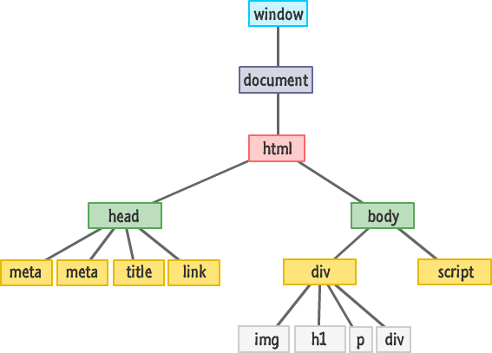
Dom Tree Examples

Slide 64
What is a Document Tree ?
The Document Tree is the relational structure of the HTML/XHTML document.
Elements within an HTML/XHTML document form a Link together in different relations.
Every element within a document tree has exactly one parent, except for the root of the tree, which has none.
So, in HTML, the root would be the HTML element, which wraps all other elements, but it is wrapped by none.

Slide 65
DOM Tree Traversal
The Element is the “smallest relevant body”.
DOM is made up of nodes ,which may be of various types.
The Element Node is just one type of node.
Another type of node is the Text Node, which is actually any span of contiguous text within the document.
  Consider: <b>Hello World!</b>.
    That's text that resides within an element.

Slide 66
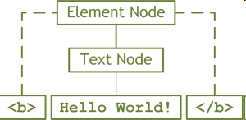
Tree Traversal
The B element is an Element Node, which is a parent of a Text Node.
The DOM makes this distinction because, when you address nodes within the DOM, you'll be replacing the Text Node that is nested within the Element Node, while not effecting the Element Node at all.

Slide 67
Try This Tree Traversal
<p>The <b>DOM</b> is <i>extremely</i> powerful!</p>
The parent node is the P element node. It has 5 children They are:
  -A text node that contains the text 'The'
  -A B element node
  -Another text node that contains the text 'is'
  -An I element node
  -The last text node that contains the text 'powerful!'

Slide 68
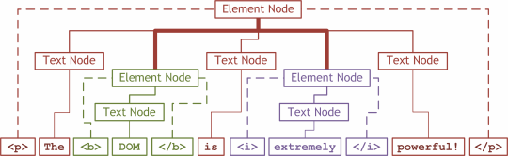
Another Example

Slide 69
This makes the element nodes and text nodes directly under the P element node siblings.
The text node that contains the text 'The' is the First Child of the P element node and text node 'powerful!' is the Last Child of the P element node.

Slide 70
Dom Tree Modification
The following methods allow JavaScript code to modify an existing DOM tree structure. Some of them are:
  insertBefore(newChild,refChild) places the new child node before the ref child node.
  replaceChild(newChild,oldChild) replaces old child with new child node.
  removeChild(oldChild) removes the specified node from the structure.
  appendChild(newChild) adds the given node to the end of the list of siblings of the node through which it is called.

Slide 71
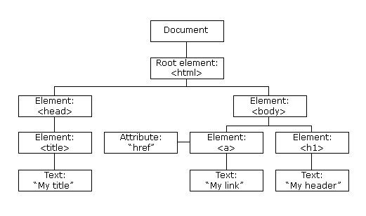
DOM Tree

Slide 72
DOM Tree
The nodes in the node tree have a relationship to each other.
Parent nodes have children.
Children on the same level are known as siblings.
In an XHTML document, the parent node is the <html> element. It is also the root node.
Any node can have one ore more children nodes.
A node with no children is known as a leaf node.

Slide 73
Update the text node
<script type="text/javascript">
function updateText(x) {
document.getElementById('p1').innerHTML = x
} </script>
<p id="p1">Click on the link below to update this element.
</p><br />
<a href="JavaScript:void(0);
updateText('Thank you for clicking me!');">Click Me!</a>

Slide 74
The getElementById method to access the paragraph element with an id of p1.
We then set the text using the innerHTML property.
  Replace with
<script type="text/javascript">
function updateText(x) { document.getElementById("p1").childNodes[0].nodeValue= x
}
</script>

Slide 75
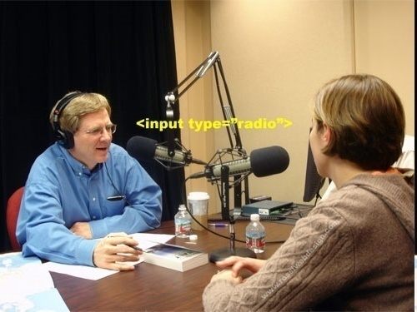
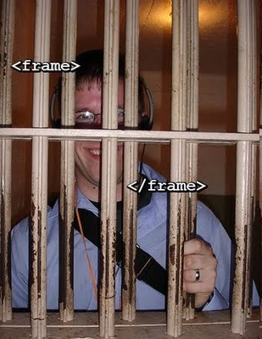
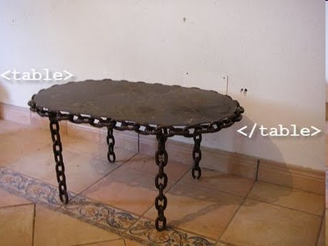
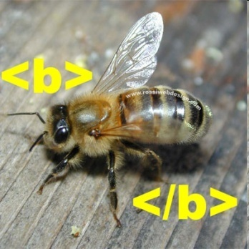
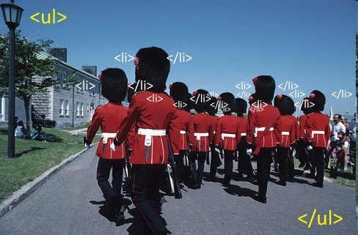
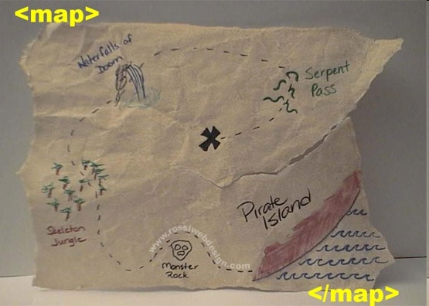
<Thank you/>

